Slide 1


Slide 2


Slide 3


When you see the change, press the spacebar to stop the images from flickering…
…then, click on the location of the distortion with your mouse!

Slide 4
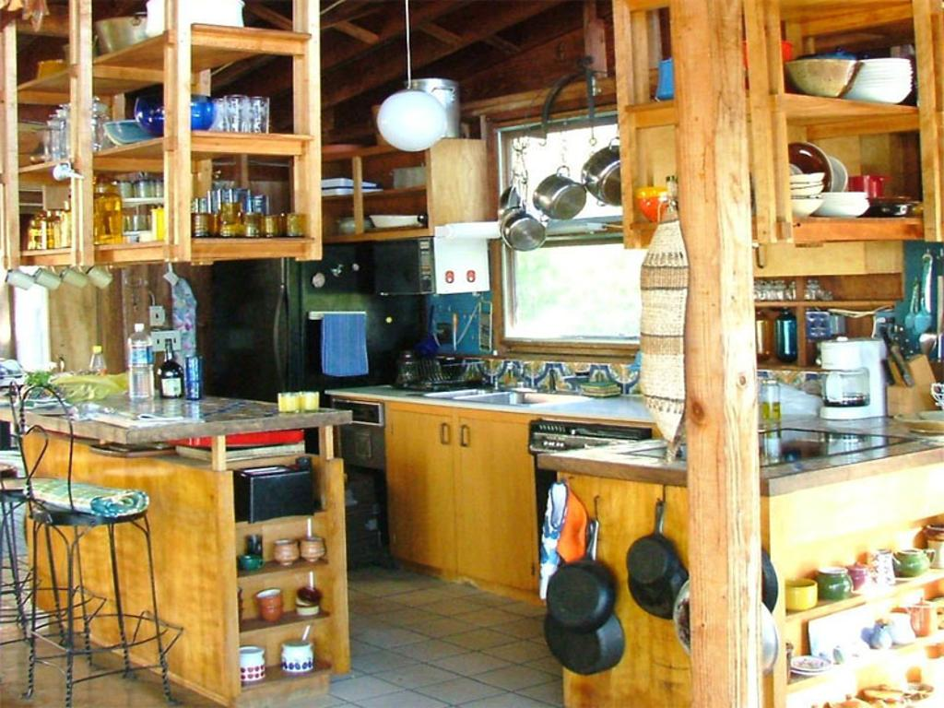

Slide 5


Slide 6
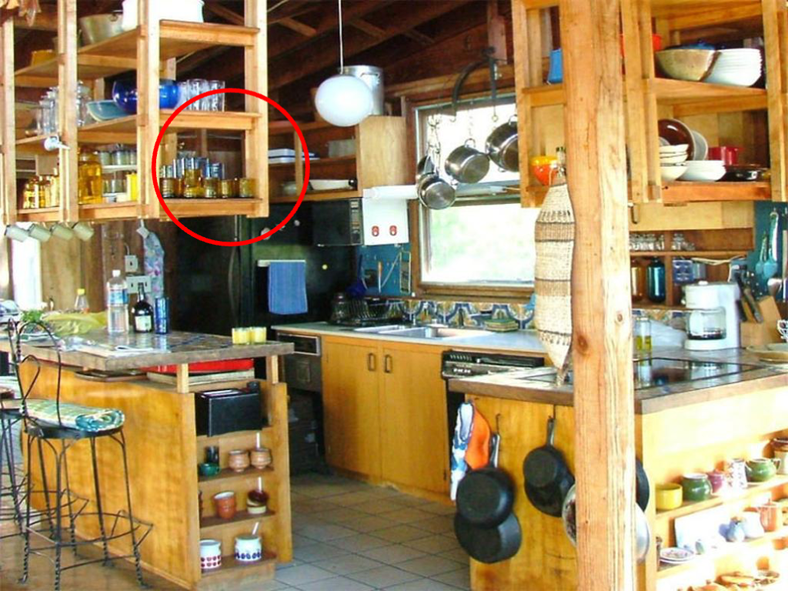
When you see the distortion, press the spacebar to stop the images from flickering…
…then, click on the location of the distortion with your mouse!

Slide 7


Slide 8


